Slide 1


How to start contributing to free5GC
Yi Chen, Software Engineer @ Saviah
You-Sheng Liu, NYCU

Slide 2

About Me
陳毅（Ian）
SDE @ Saviah（禾薪科技）
free5GC/SD-CORE Contributor
Book Author
EN 帶你入門 5G 核心網路
EN 帶你寫個作業系統
Speaker at COSCUP/SITCON/GDG DevFest…

Slide 3
Outline
What is the free5GC?
5GC Overview
free5GC implementation details
How to contribute?
Q&A

Slide 4



What is free5GC?
The free5GC is an open-source project for 5th generation (5G) mobile core networks.
Major contributors are from National Yang Ming Chiao Tung University
Currently, we’re working on:
Upgrade to 3GPP release 17
Support OAuth 2.0
Support Converged Charging
Use Case
Integrated with

Slide 5
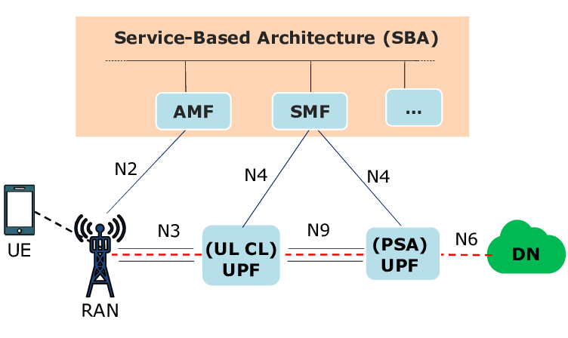
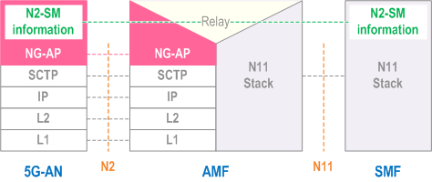
5GC Overview
All of the Network Functions communicate with each other via SBA.
Each Network Function exposes its service interface to provide the dedicated service.
Proprietary hardware is not needed (leverage from NFV).

Slide 6
5GC Overview
AMF (Access and Mobility Management Function)
SMF (Session Management Function)
UPF (User Plane Function)
AUSF (Authentication Server Function)
NSSF (Network Slice Selection Function)
PCF (Policy Control Function)
UDR (Unified Data Repository)
UDM (Unified Data Management)
NRF (Network Repository Function)
CHF (Charging Function)

Slide 7
5GC Overview
Service-Based Interface procedure type:
Query (Resource)
Subscription
Notification
AUSF
(consumer)
UDM
(producer)
Nudm_UEAuthentication_Get Request

Slide 8
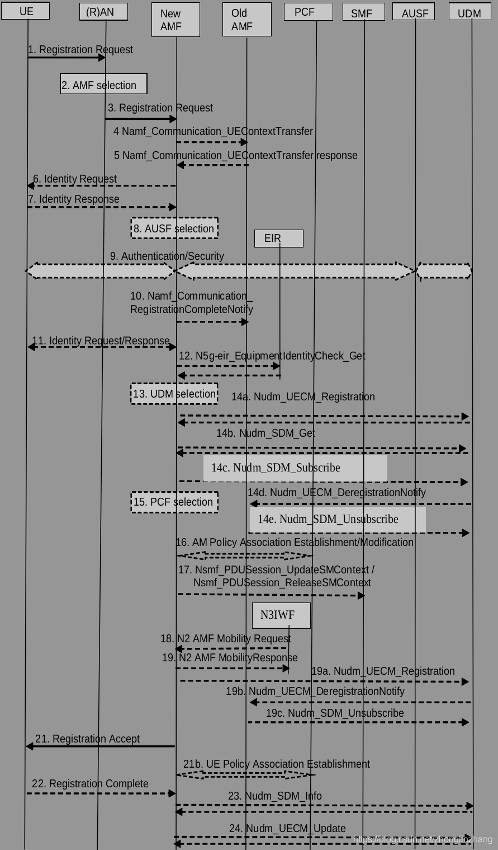
5GC Overview - Registration

Slide 9
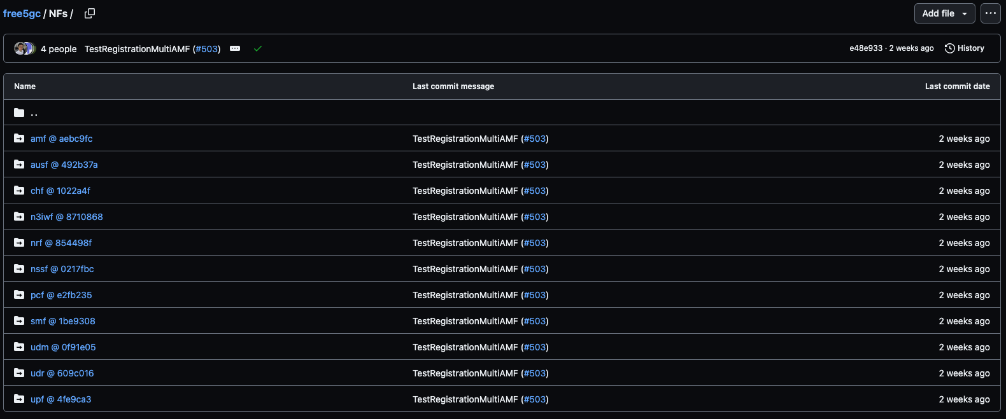
free5GC implementation details

Slide 10
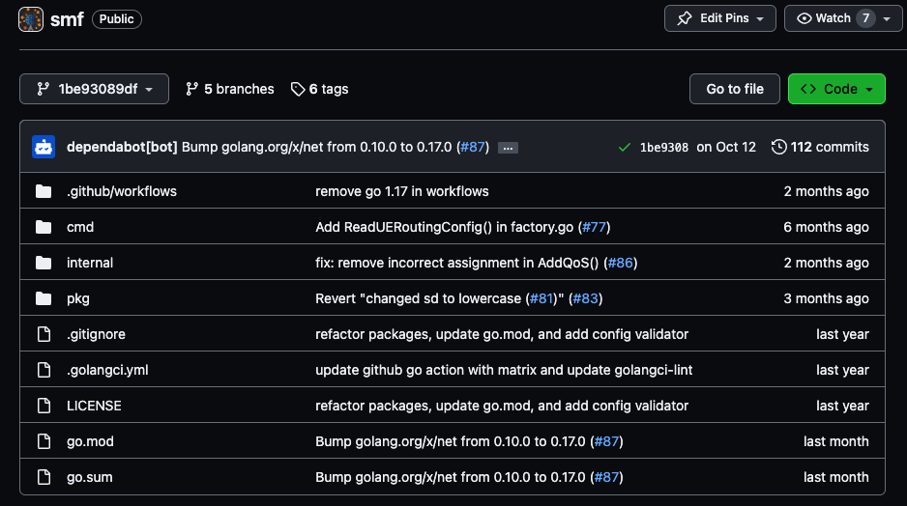
free5GC implementation details
Cmd
Entry point
Internal
Context
Logger
Pfcp
Sbi
Pkg
Pkg
Service
Association
Factory

Slide 11

Live Demo
Notes:
以 SMF 為例講解

Slide 12
How to Contribute?
Network Function
Dedicated interface(s)
SBI service(s)
Functionality, Reliability
Deployment
Host
Docker Compose
K8s

Slide 13
How to Contribute?
OAM
UI
Backend
Test
Integration test
Unit Test
Fuzzing
Data Plane
Linux Kernel

Slide 14
How to Contribute?
Protocol
NGAP
NAS
PFCP
GTP-U
Blog
Use cases

Slide 15
Q & A

Slide 16
Thank you!

Slide 17


